Slide 1
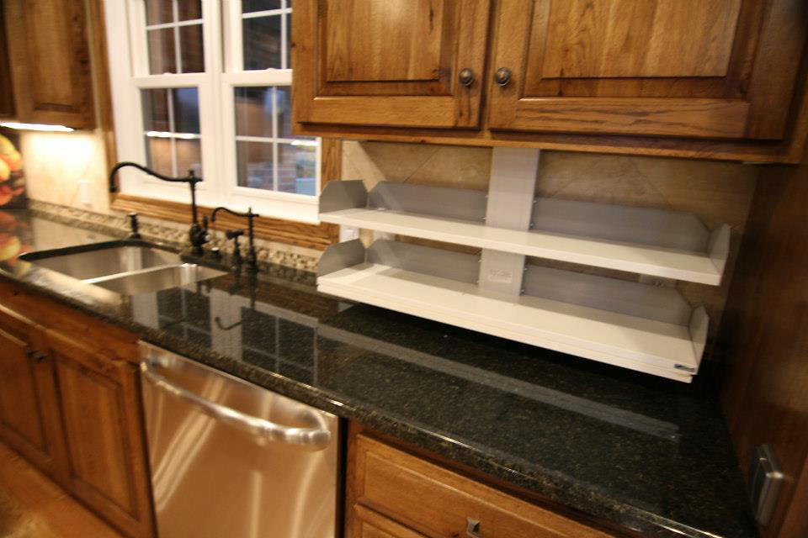
Smart Homes for Disabled Veterans
iPad-controlled lighting, HVAC, security, entertainment
Motorized cabinets that raise and lower contents
Mirrors that tilt downward
Motorized doors

Slide 2
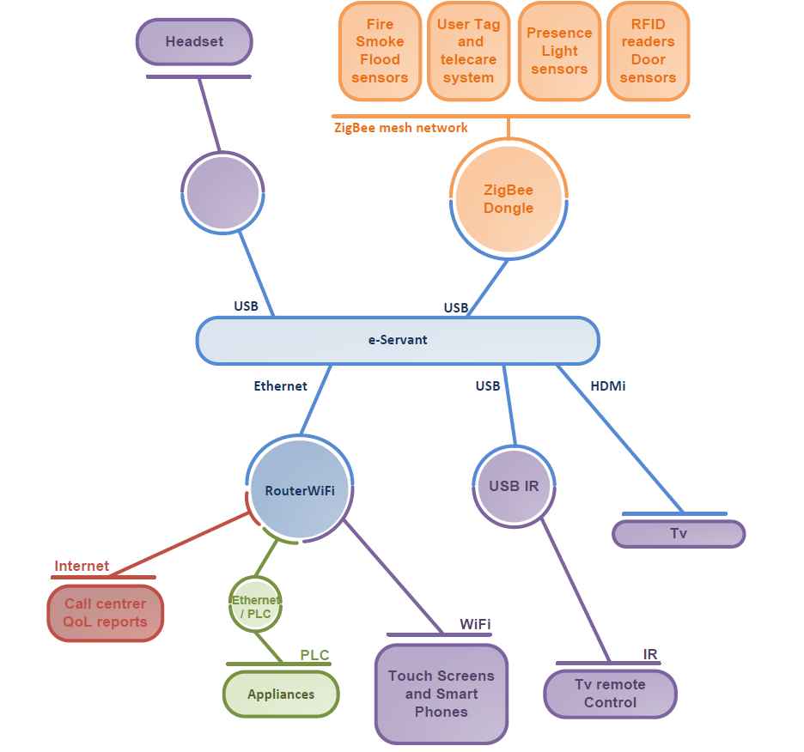
Smart Kitchen for Disabled/Elderly People
Connect existing smart devices with e-servant to form kitchen network
Variable assistance based on needs
Detect and react to emergencies
Give notifications about events
Learn routines and watch for changing habits

